Slide 1


<Oghenerunor Idolor>
<07/05/2004>

Slide 2

Outline
Executive Summary
Introduction
Methodology
Results
Conclusion
Appendix

Slide 3
Executive Summary
Text:
Predicted successful landings of SpaceX Falcon 9 first stages using classification models.
Combined data from web scraping, API calls, and CSV files.
Used visualization, SQL, mapping (Folium), and dashboarding (Plotly Dash).
Decision Tree achieved highest test accuracy: ~90%.
Built tools and insights to support mission planning and booster reuse.

Slide 4
Introduction
SpaceX aims to reduce launch costs via first-stage recovery.
Challenge: Predict which conditions lead to successful landings.
Our goal: Build a data-driven, interactive system to analyze and predict outcomes
.

Slide 5

Section 1

Slide 6
Methodology
Executive Summary
Data collection methodology:
Describe how data was collected
Perform data wrangling
Describe how data was processed
Perform exploratory data analysis (EDA) using visualization and SQL
Perform interactive visual analytics using Folium and Plotly Dash
Perform predictive analysis using classification models
How to build, tune, evaluate classification models

Slide 7
.
Data Collection
Used SpaceX API to retrieve launch data.
Complemented with manual CSV files and web scraping for booster details.
Data sources: REST API (SpaceX), Web (Wikipedia), and cloud-hosted CSVs

Slide 8
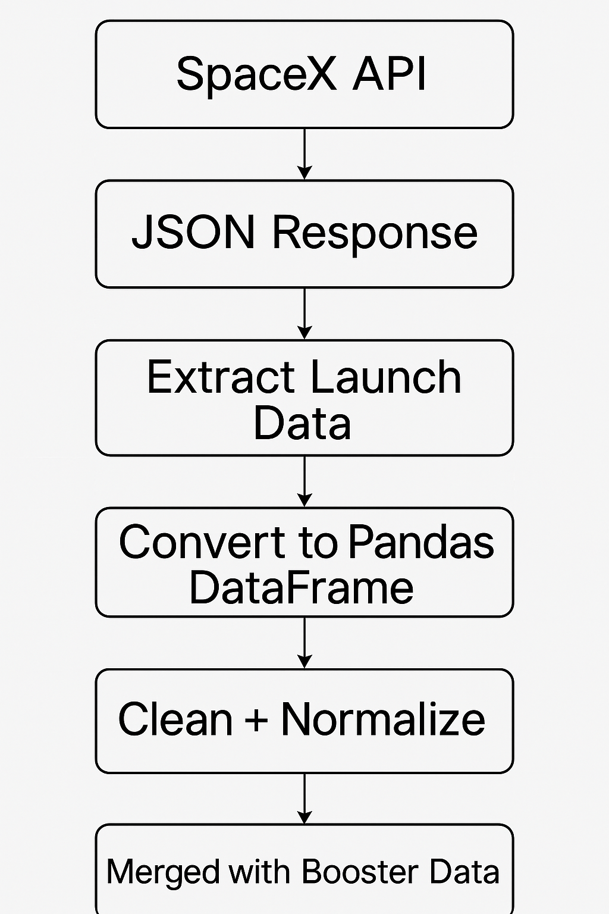
Data Collection – SpaceX API
Present your data collection with SpaceX REST calls using key phrases and flowcharts
Add the GitHub URL of the completed SpaceX API calls notebook (https://github.com/Runada1x/coursera-stuff/blob/main/jupyter-labs-webscraping%20(1).ipynb )as an external reference and peer-review purpose

Slide 9
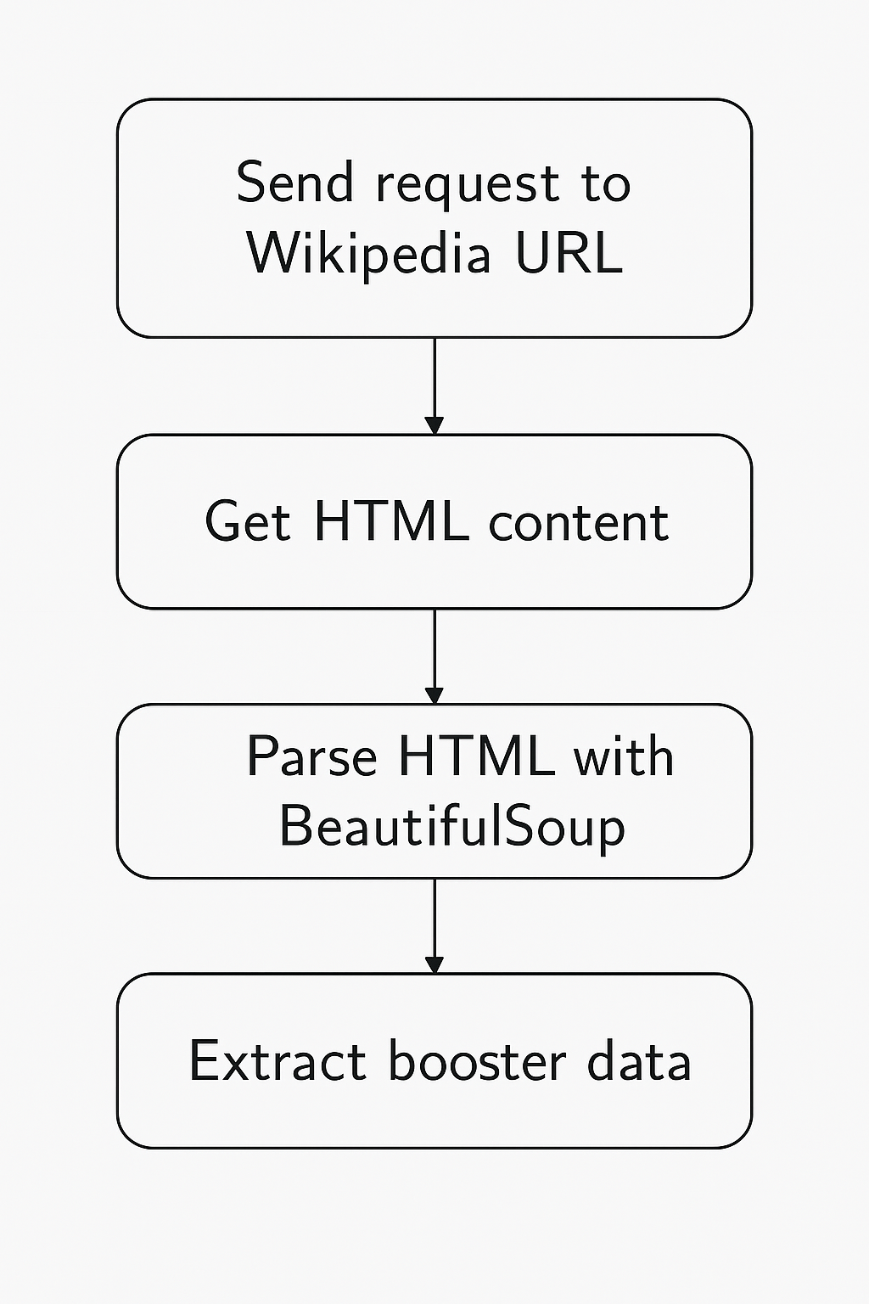
Data Collection - Scraping
Present your web scraping process using key phrases and flowcharts
Add the GitHub URL of the completed web scraping notebook, as an external reference and peer-review purpose

Slide 10
Data Wrangling
Cleaned nulls, converted dates, encoded categorical variables.
Merged multiple dataframes to form unified feature matrix for model training.
Standardized payload units; filtered irrelevant data points
https://github.com/Runada1x/coursera-stuff/blob/main/labs-jupyter-spacex-Data%20wrangling%20(2).ipynb

Slide 11
EDA with Data Visualization
Histogram (Payload Mass): Showed distribution of payloads and identified range concentration.
Boxplot (Payload vs. Success): Showed that higher payloads were correlated with lower landing success.
Bar Plot (Orbit vs. Success): Visualized orbit type impact on success rates.
Heatmap (Correlation Matrix): Helped identify relationships among numeric features (e.g., FlightNumber, PayloadMass, etc.)
Count Plot (Launch Site vs. Outcome): Exposed launch site success rate imbalance.These visuals allowed us to identify patterns and narrow down key predictors for modeling.
https://github.com/Runada1x/coursera-stuff/blob/main/edadataviz%20(1).ipynb

Slide 12
EDA with SQL
SQL Queries Summary:
Selected launch sites with the highest number of successful landings.
Filtered missions with Landing Outcome = 'Success' to evaluate trends.
Calculated average payload mass per orbit and launch site.
Grouped launches by year to observe yearly launch volume trends.
Identified booster version categories with the most successful landings.
These queries allowed structured EDA from the relational perspective and complemented visual analytics.
https://github.com/Runada1x/coursera-stuff/blob/main/jupyter-labs-eda-sql-coursera_sqllite_solution%20(1).ipynb

Slide 13
Build an Interactive Map with Folium
Map Objects Created:
Markers: Plotted each launch site using folium.Marker().
Circle Markers: Added colored circles for success/failure visual cues.
Popups: Each marker showed the site name and coordinates.
Distance Lines (Optional): Calculated and plotted lines from launch site to nearby landmarks (e.g., coast).
Purpose: To visualize geographic distribution of launch sites. Help correlate location with landing success. Enhance stakeholder interactivity with clear spatial context.
https://github.com/Runada1x/coursera-stuff/blob/main/lab_jupyter_launch_site_location%20(3).ipynb

Slide 14
Build a Dashboard with Plotly Dash
Dashboard Elements:
Dropdown Filter: Allows users to select a specific launch site.
Pie Chart: Shows success vs. failure count for selected site.
Payload Slider: Adjusts payload mass range in real time.
Scatter Plot: Displays payload vs. landing outcome, filtered by site & payload range.
Why These Features?
To let users explore patterns dynamically.
Helps stakeholders visually compare success rates by site.
Payload slider provides insight into mass-performance relationship.
github.com/Runada1x/coursera-stuff/blob/main/spacex-dash-app%20(1).py

Slide 15
Predictive Analysis (Classification)
Model Development Process:
Used StandardScaler() to standardize features.
Split data using train_test_split() with 20% test size.
Trained 4 classifiers: Logistic Regression, SVM, Decision Tree, KNN.
Tuned hyperparameters with GridSearchCV (cv=10).
Evaluated using test accuracy and confusion matrix.
Best performer: Decision Tree (CV accuracy ≈ 90.2%)
https://github.com/Runada1x/coursera-stuff/blob/main/SpaceX_Machine%20Learning%20Prediction_Part_5%20(1).ipynb

Slide 16
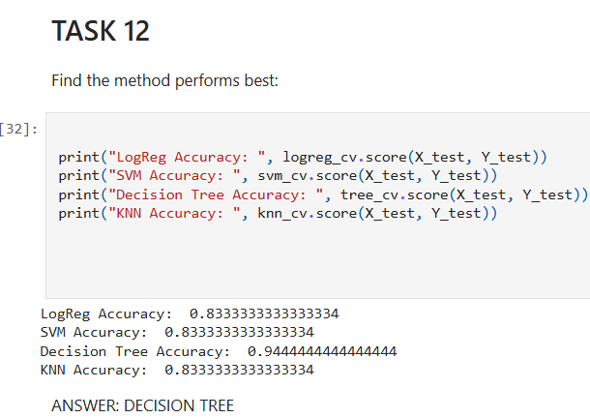
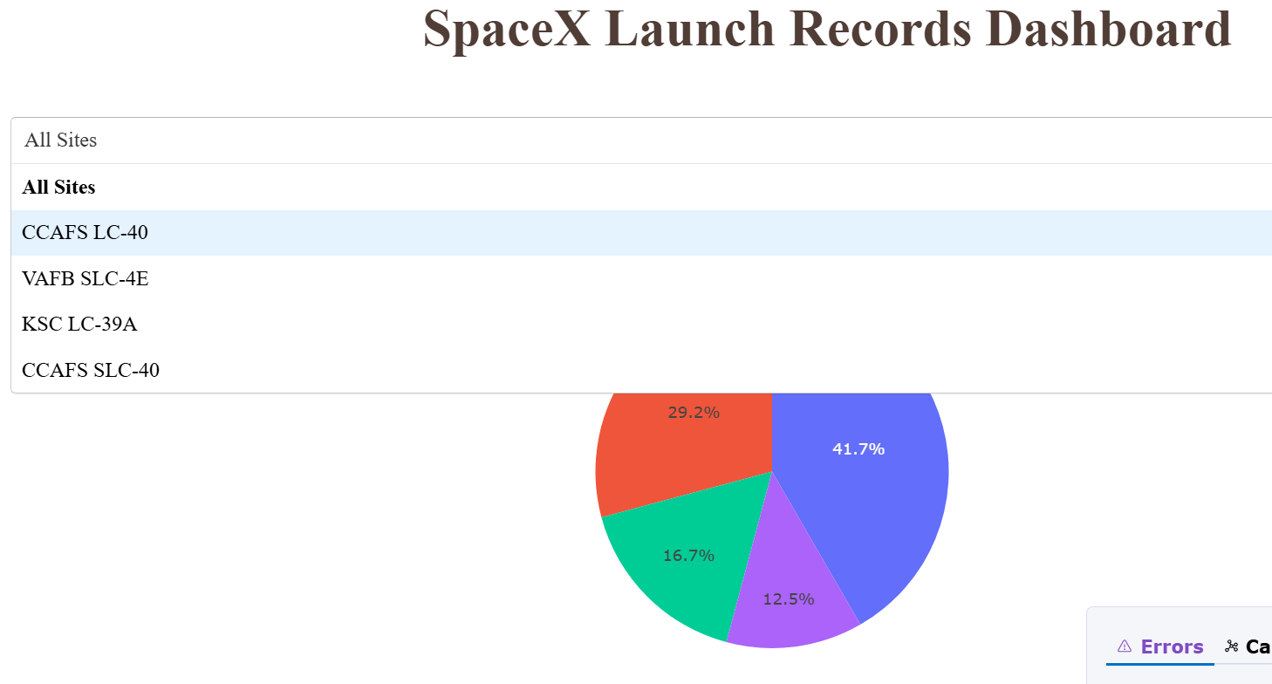
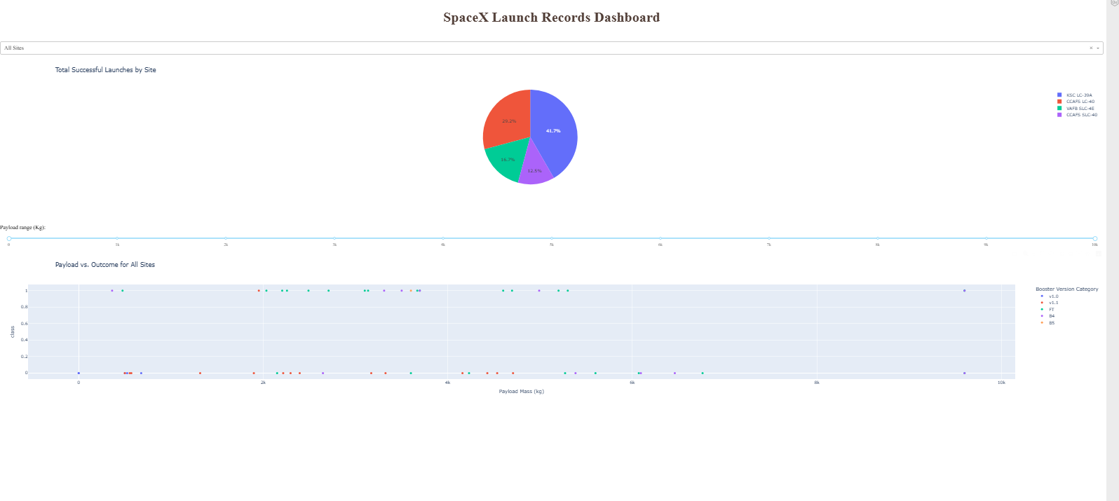
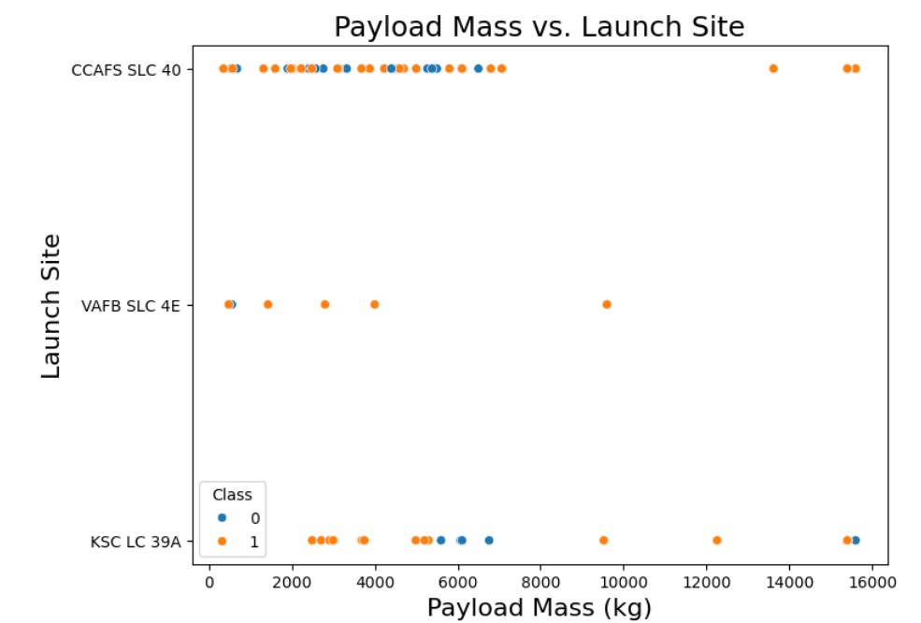
Results

Slide 17

Section 2

Slide 18
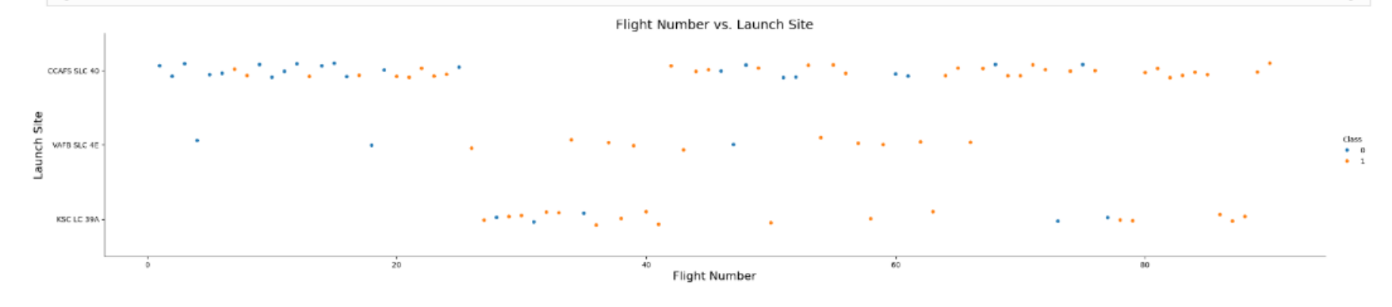
Flight Number vs. Launch Site
The scatter plot reveals a clear pattern: earlier missions with lower flight numbers were more prone to failure (represented by blue dots). As the flight number increases indicating more mission experience and likely engineering improvementsthe rate of successful landings (orange dots) also increases. Notably, the KSC LC 39A launch site exhibits a consistent cluster of high flight numbers with successful outcomes, suggesting that both accumulated experience and site-specific factors contribute to mission success. This trend supports the hypothesis that operational maturity directly enhances landing performance.

Slide 19
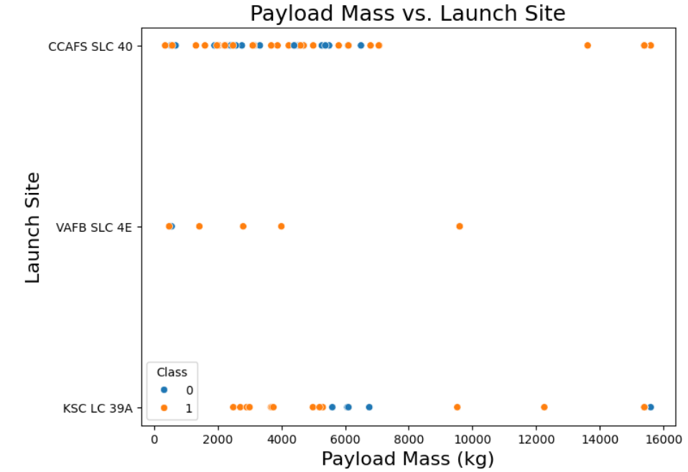
Payload vs. Launch Site
This scatter plot shows how payload mass relates to landing success across different launch sites. Lower payloads have mixed outcomes. As payload increases, successful landings become more common, especially at KSC LC 39A and CCAFS SLC 40. This suggests heavier missions are more likely to succeed, possibly due to better preparation or more advanced hardware.

Slide 20
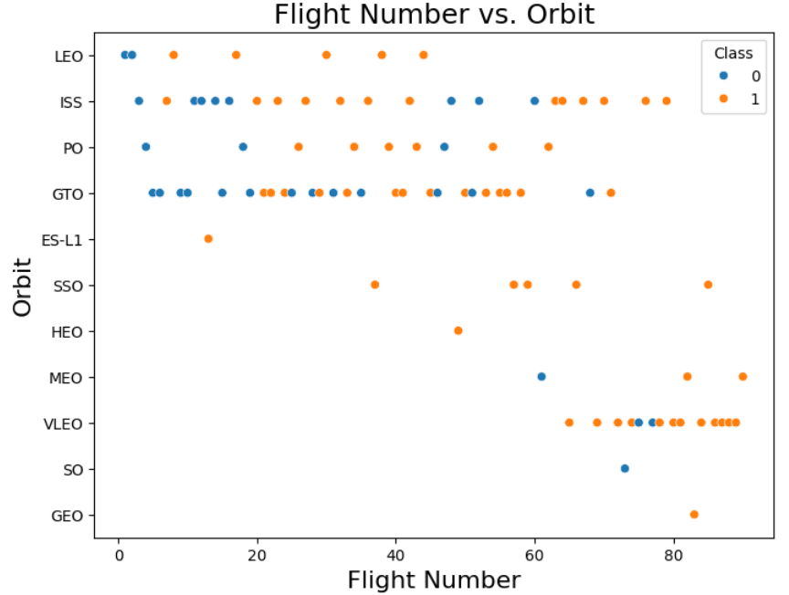
Flight Number vs. Orbit Type
This plot shows how orbit type relates to mission success over time. For earlier flights, success was inconsistent across all orbits. Over time, success became more frequent in orbits like LEO, GTO, and VLEO. The presence of failures in early flight numbers suggests that technical maturity played a role. The consistent success in later missions across multiple orbits reflects improved systems and greater mission reliability.

Slide 21
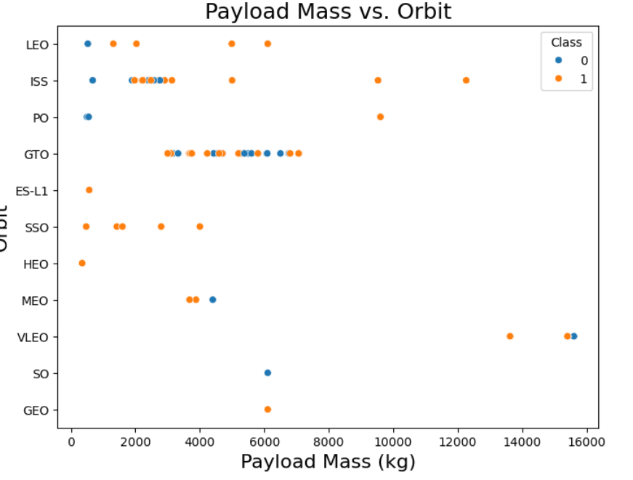
Payload vs. Orbit Type
This chart compares payload mass with orbit type and landing success. Lower mass payloads appear across many orbits, but most heavier payloads are concentrated in orbits like GTO and VLEO. Success is more frequent with these high-mass missions, suggesting they are typically better supported and executed. Lighter missions have mixed outcomes, especially in orbits like LEO and ISS.

Slide 22
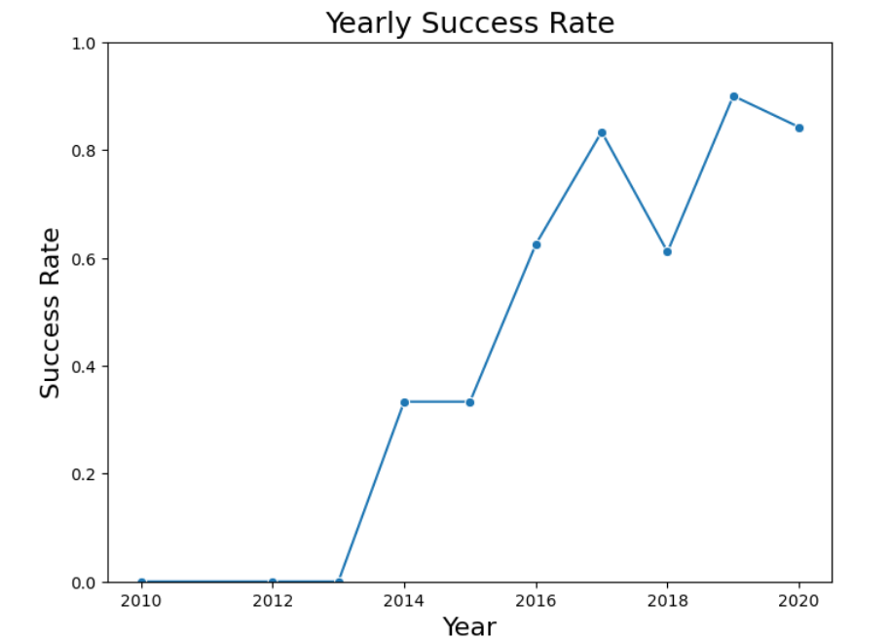
Launch Success Yearly Trend
This line chart shows how SpaceX’s launch success rate improved over time. From 2010 to 2013, success was nonexistent. The rate began rising in 2014 and showed major gains by 2016. Peaks in 2017 and 2019 reflect strong operational maturity. The overall trend highlights consistent improvement and growing mission reliability.

Slide 23
All Launch Site Names
This query retrieves all the unique launch site names from the dataset. Using DISTINCT ensures we only get one record for each site, even if it appears multiple times in the data. This helps us understand how many different locations SpaceX has launched from.
KSC LC-39A
CCAFS LC-40
VAFB SLC-4E
CCAFS SLC-40
SELECT DISTINCT Launch_Site FROM SPACEX_LAUNCH_GEO;

Slide 24
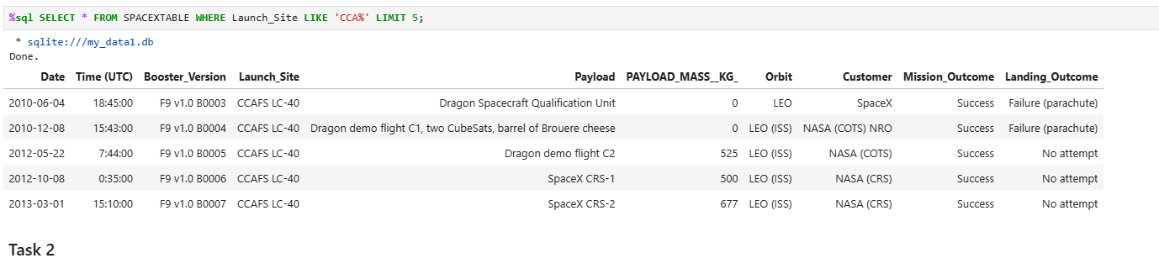
Launch Site Names Begin with 'CCA'
This query retrieves the first 5 records from the dataset where the launch site name begins with "CCA", which corresponds to Cape Canaveral Air Force Station (CCAFS). This helps filter and explore only missions launched from that location, which is one of SpaceX's most frequently used sites.

Slide 25
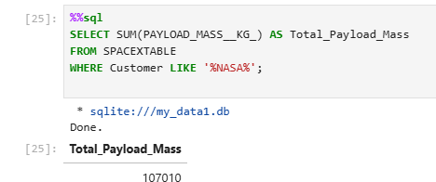
Total Payload Mass
This query calculates the total payload mass carried by all SpaceX missions associated with NASA. It does this by summing up the values in the PAYLOAD_MASS__KG_ column for all records where the Customer field contains the substring “NASA.” This includes missions labeled as “NASA (CRS),” “NASA (COTS),” or any other variation involving NASA. The result is a single numerical value representing the total payload delivered under NASA contracts.

Slide 26
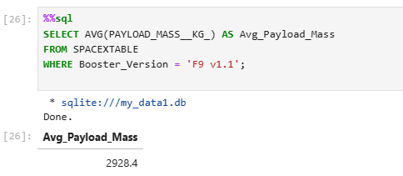
Average Payload Mass by F9 v1.1
This query computes the average payload mass carried specifically by the F9 v1.1 booster version. It filters the dataset for records where the Booster_Version field matches this version, then uses the AVG() function to calculate the mean of all associated PAYLOAD_MASS__KG_ values. The result reflects the typical payload capacity achieved by this version during its operational launches.

Slide 27
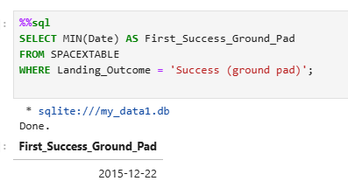
First Successful Ground Landing Date
This query filters the dataset to only include records where the Landing_Outcome was a success on the ground pad. It then returns the earliest date using the MIN() function. This allows us to identify when SpaceX first achieved a successful ground landing, a critical milestone in reusable rocket technology.

Slide 28
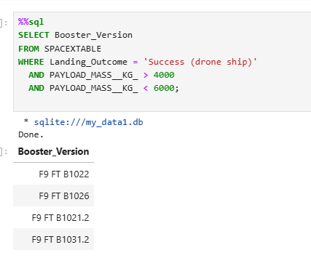
Successful Drone Ship Landing with Payload between 4000 and 6000
This query filters the dataset to find only those booster versions that had a successful landing on a drone ship and carried a payload between 4000 kg and 6000 kg. These results highlight boosters capable of mid-range payload recovery via drone ships—an important capability for improving cost efficiency through reusable launches.

Slide 29
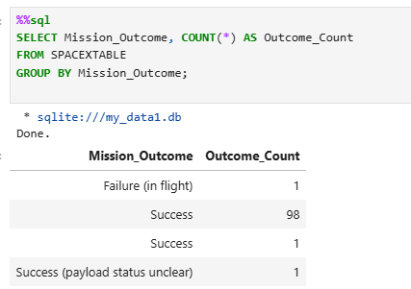
Total Number of Successful and Failure Mission Outcomes
This query groups the data by the Mission_Outcome field and counts how many times each unique outcome occurred. It provides a breakdown of how often SpaceX missions succeeded or failed, which helps in assessing the overall mission reliability and improvements over time.

Slide 30
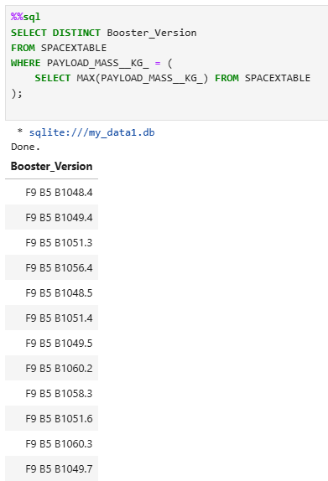
Boosters Carried Maximum Payload
This query uses a subquery to first find the maximum payload mass, then selects the distinct booster versions that achieved this payload. It helps highlight the most capable booster configurations in the dataset.

Slide 31
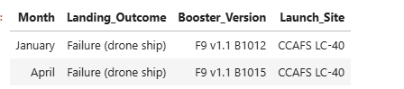
2015 Launch Records
This query extracts all 2015 launches that failed drone ship landings, converting month numbers to readable names using a CASE statement. The result includes each failure’s booster version and launch site, helping identify patterns or issues specific to that year.

Slide 32
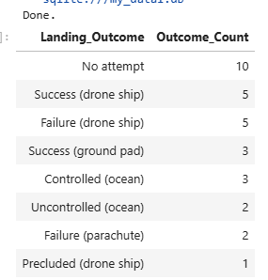
Rank Landing Outcomes Between 2010-06-04 and 2017-03-20
This query filters launch data to only include missions between June 4, 2010, and March 20, 2017, then groups the results by Landing_Outcome. It counts how many times each outcome occurred and ranks them in descending order. This helps identify which landing methods were most and least successful during that early operational period.

Slide 33

Section 3

Slide 34
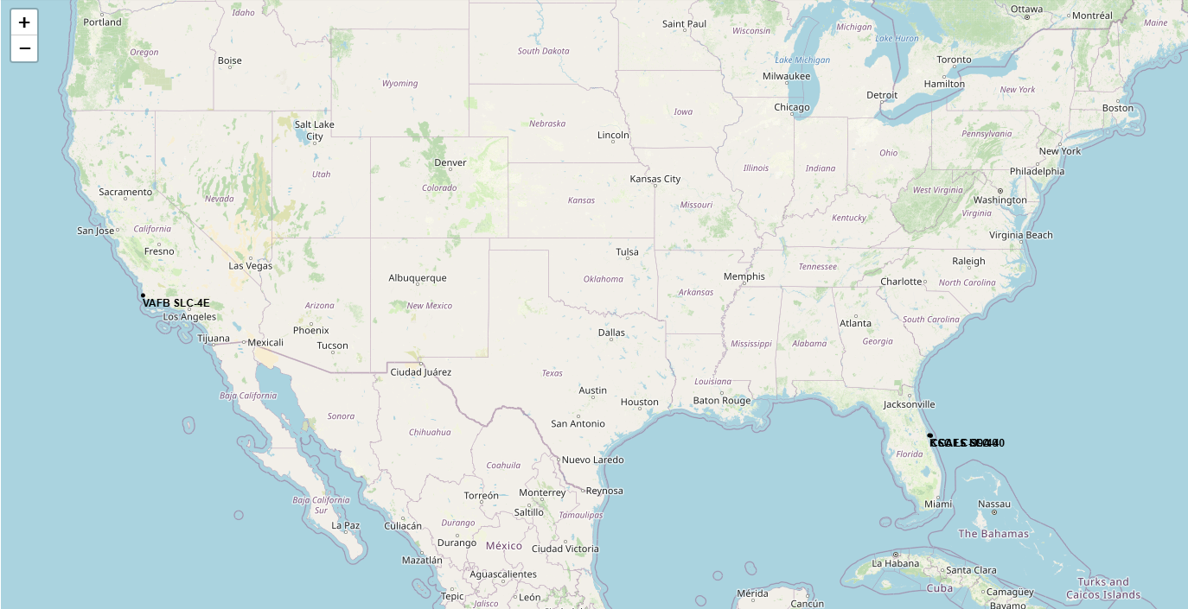
Global Distribution of SpaceX Launch Sites
The map reveals that most SpaceX launch activities are concentrated in the U.S., with CCAFS and KSC situated in Florida and VAFB in California.

Slide 35
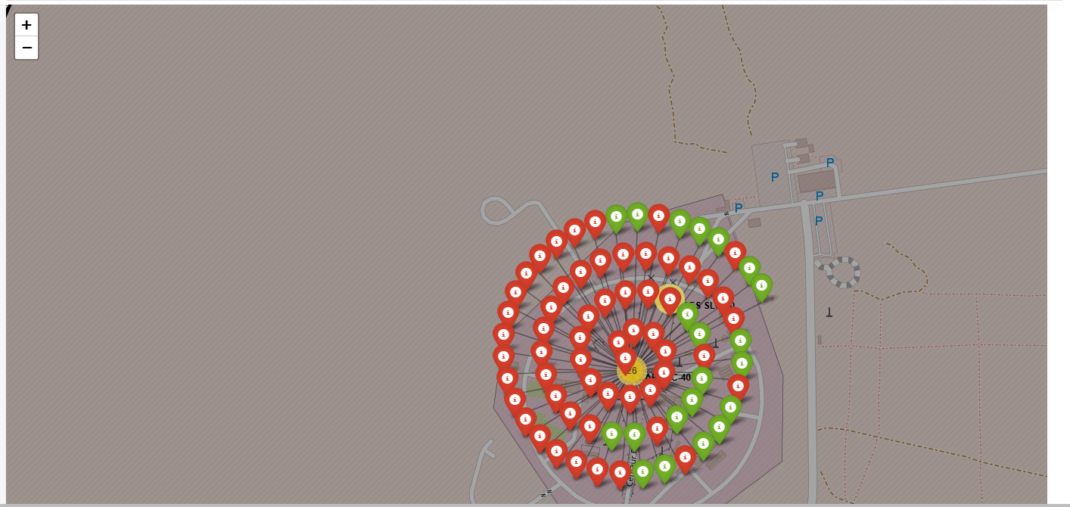
Launch Outcome Visualizations on Folium Map
The map highlights that most launch sites had a high success rate, especially CCAFS LC-40 and KSC LC-39A. A few failures are seen at VAFB SLC-4E, offering a spatial understanding of mission reliability across different facilities.

Slide 36
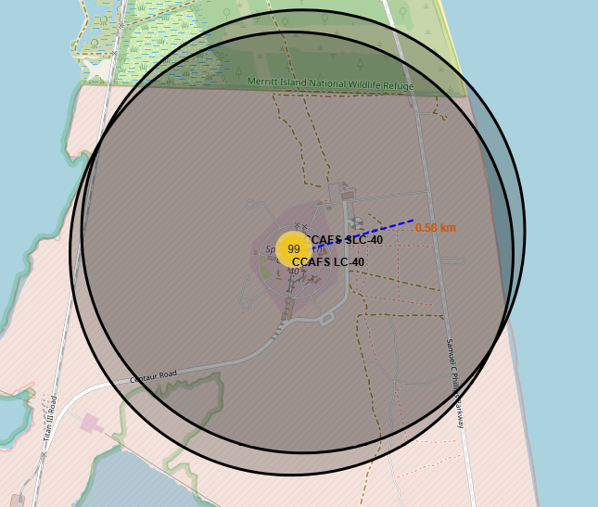
Launch Site Proximity Analysis Using Folium
This analysis helps determine the logistical feasibility of each launch site. For example, the selected site is close to major infrastructure, which is ideal for transporting heavy payloads and coordinating recovery missions.

Slide 37

Section 4

Slide 38
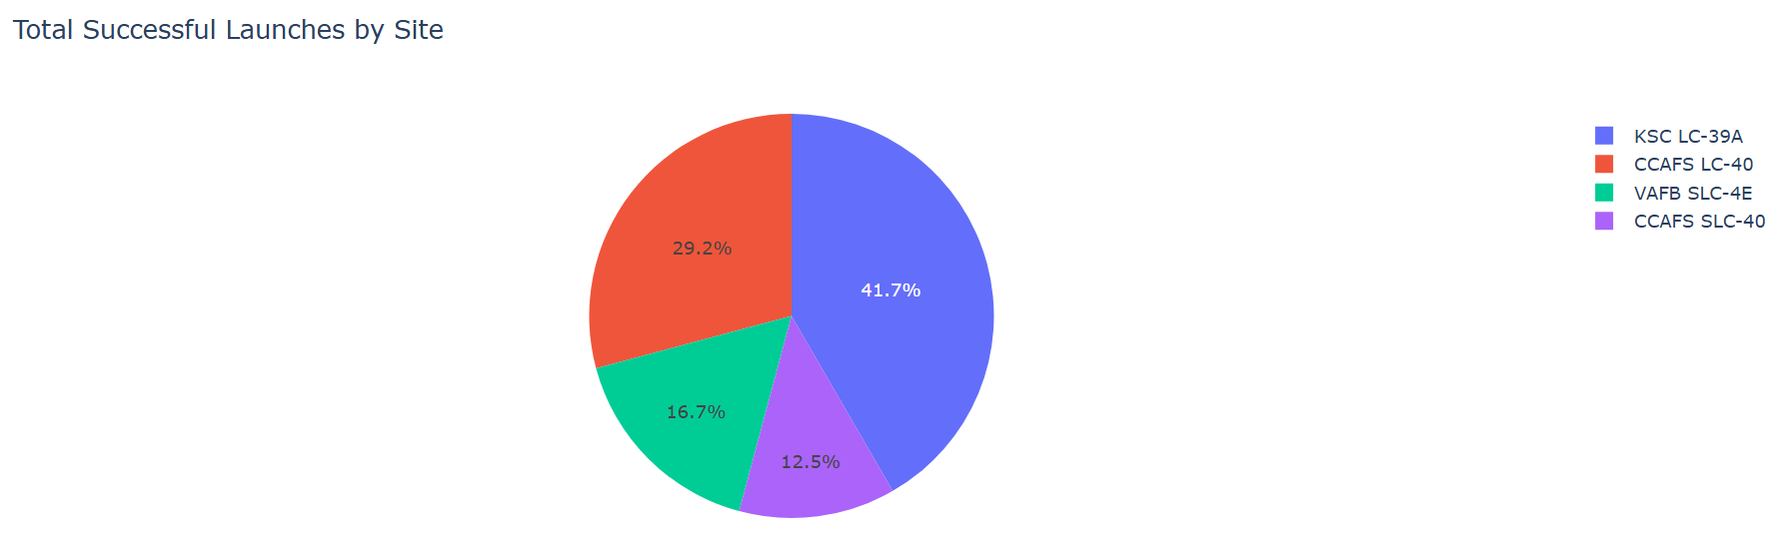
Launch Success Counts by Site
This pie chart displays the proportion of successful launches at each SpaceX launch site. KSC LC-39A leads with 41.7% of the total successful missions, followed by CCAFS LC-40 at 29.2%. This chart helps identify which sites have been the most active and successful historically, providing insight into operational efficiency and reliability.

Slide 39
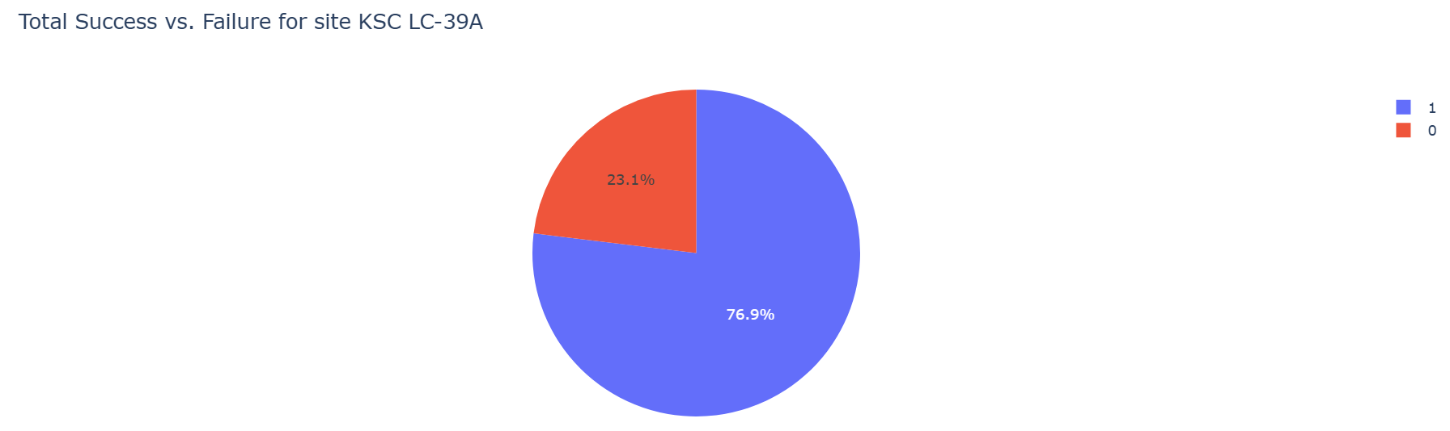
Launch Success Rate at KSC LC-39A
This pie chart displays the success vs. failure distribution for the launch site KSC LC-39A, which had the highest launch success ratio among all SpaceX launch sites. As seen in the chart, successes make up 76.9% of launches from this site, with failures at 23.1%. This high success rate highlights KSC LC-39A’s reliability as a launch location and justifies its selection for deeper analysis in the dashboard.
Replace

Slide 40
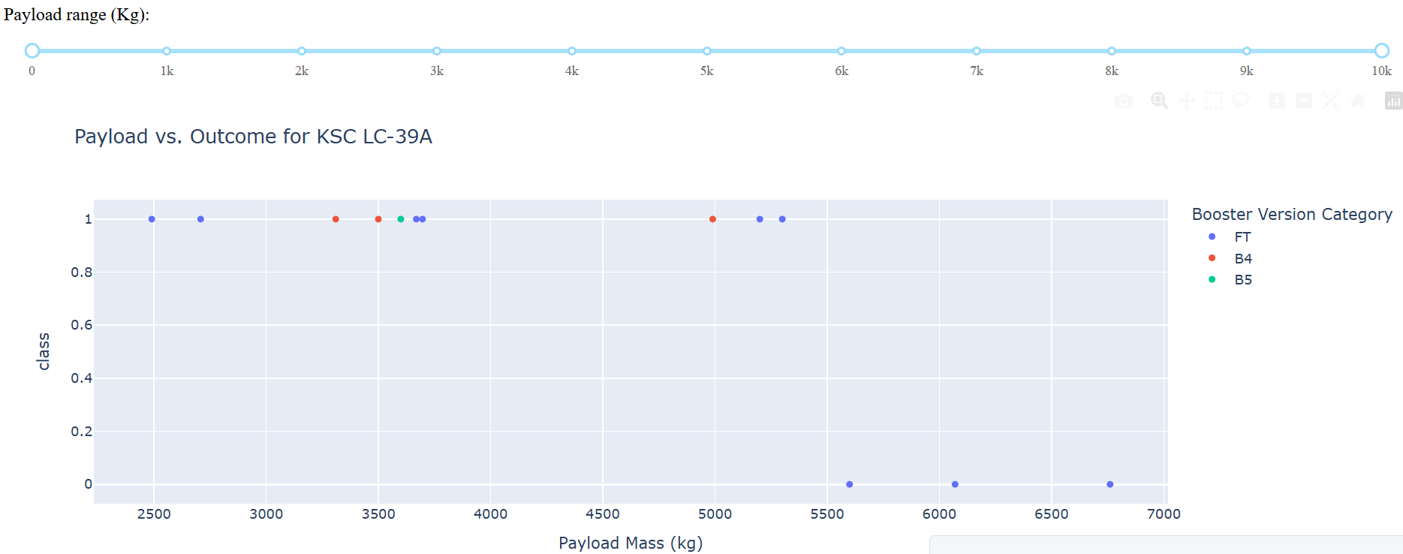
<Dashboard Screenshot 3>
This scatter plot shows payload mass vs. launch outcome at KSC LC-39A across booster versions. The full slider range (0–10,000 kg) reveals that all booster types (FT, B4, B5) achieve success, though FT dominates. Failures mostly occur at higher payloads, but success isn’t limited to lighter missions.

Slide 41

Section 5

Slide 42
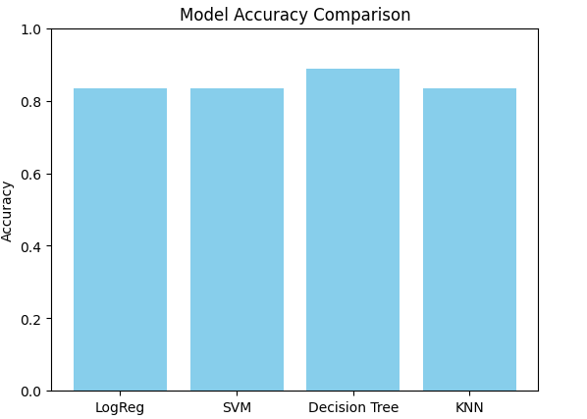
Classification Accuracy
ANSWER: Decision Tree is best

Slide 43
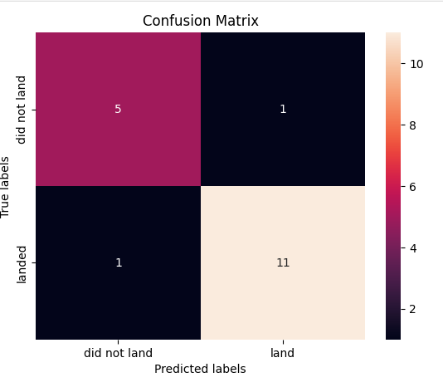
Confusion Matrix
Confusion Matrix Explanation (Best Performing Model - Decision Tree):The confusion matrix shows that the Decision Tree classifier accurately predicted 5 out of 6 “did not land” cases and 11 out of 12 “landed” cases. This demonstrates a high classification performance with minimal misclassifications (just one error in each class). The model exhibits strong reliability for both classes.

Slide 44
Conclusions
Predictive models can accurately forecast SpaceX landing outcomes Machine learning model especially the Decision Tree classifier achieved up to 94% accuracy, proving that historical launch data can be effectively used to predict future mission success
.Key features like booster version, payload mass, and launch site drive mission success Feature engineering and EDA identified these variables as the most influential in determining whether a launch would result in a successful landing.
Decision Trees outperform other classifiers while offering interpretability Compared to SVM, Logistic Regression, and KNN, the Decision Tree not only delivered the best accuracy but also provided clear decision rules, making it suitable for real-world operational use.
Cross-validation and hyperparameter tuning are essential for robust models Using 10-fold GridSearchCV ensured that model performance was not dependent on a single train-test split, increasing confidence in the results.
Visual analytics and geospatial tools enhance insight and communication Tools like Folium and Plotly Dash allowed for interactive, spatial, and statistical exploration of the data, turning raw numbers into actionable insights for both technical and non-technical stakeholders.

Slide 45


